Slide 1
Emotionally Expressive Motion Controller for Virtual Character Locomotion Animations
Diogo Silva
Prof. Pedro A. Santos & Prof. João Dias

Slide 2
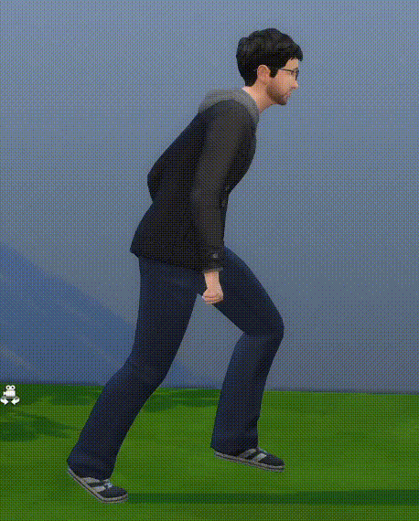
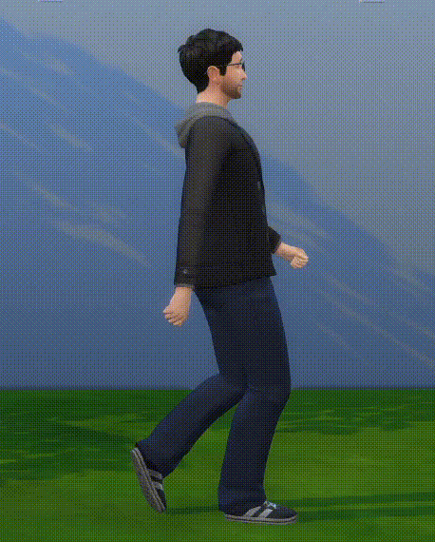
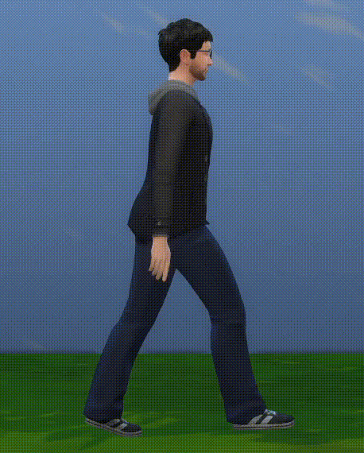
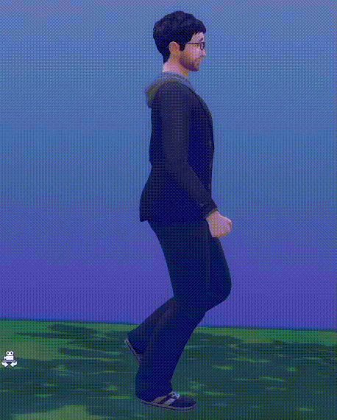
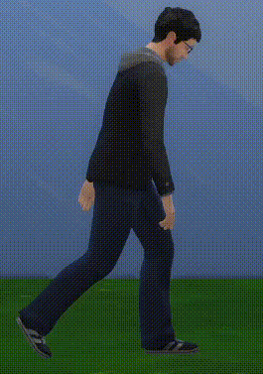
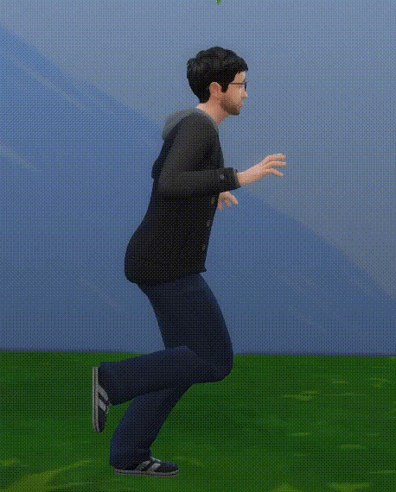
MOTIVATION
"Angry"
"Confident"
"Neutral"
[The Sims 4, Maxis, 2014]
"Energized"
"Sad"
"Afraid"
Notes:
1. Emotional Expressiveness is important in animation para as fazer crediveis, e criar impacto no visualizador
2. Expressao Emocional pode ser feita por expressao facial, voz, ou, no nosso caso, Linguagem Corporal
3. Exemplo do Sims 4

Slide 3
PROBLEM
New Animation for each Emotion
Variants of Baseline
Repeat Process for each Motion
Time Consuming & Expensive
Animation Stack
[The Sims 4, Maxis, 2014]
Notes:
1. For each new emotion the character has to convey, a new variant animation of the baseline has to be created
2. Problem persists on both conventional computer animation using mocap references AND automatically generated motions
3. This has to be repeated for every different motion
4. Not scalable -> The more emotions the more animations for each motion. The more motions, the more the animation stacks
5. Time Consuming/Expensive/Needs reference mocap to be available

Slide 4
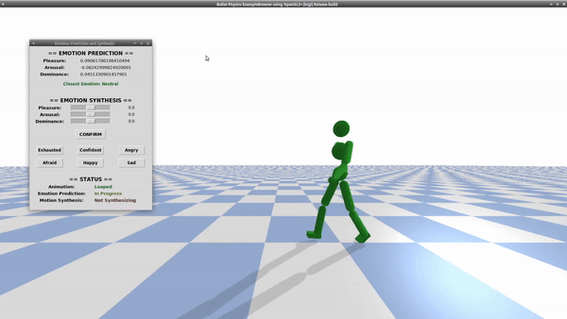
SOLUTION
Real-Time Emotion Identification & Synthesis
Focused on Locomotion
Emotions described using the PAD Emotional Model
Works with both Kinematic & Policy-Based Physics-Enabled characters
Based on Machine Learning & Laban Movement Analysis
Emotionally Expressive Motion Controller
Notes:
1. To solve this problem we propose the Emotionally Expressive Motion Controller Framework
2. Tool that allows for both Emotional Prediction and Emotionally Expressive Motion Synthesis in Real Time, without the need of any additional data
3. System uses a combination of Laban Movement Analysis and Machine Learning in order to, not only predict the character's current emotional coordinates in the Pleasure Arousal Dominance model,
But also to allow new desired emotions to be specified, with the system synthesizing and altering the character's motion in real time to convey the new emotion
4. System works with both conventional, mocap-drive Kinematic computer animation and policy-based physics enabled animations generated by state of the art DRL Systems
5. Work has been accepted for publishing at IEEE International Symposium of Multimedia
6. Parallel work is being developed and prepared for publishing in the Virtual Reality Journal

Slide 5
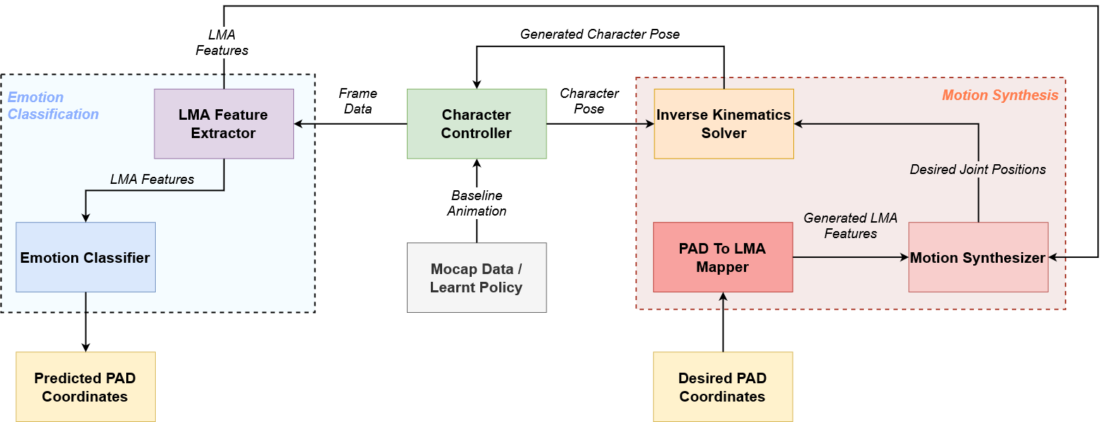
EMOTIONALLY EXPRESSIVE MOTION CONTROLLER
Notes:
1. The Emotionally Expressive Motion Controller Framework can be divided into 2 main subsystems – The Emotion Classification and The Emotionally Expressive Motion Synthesis
2. For Emotion Classification, the system begins by computing a set of LMA features from the frame data extracted from the character. These features are then fed to the Emotion Classifier module which outputs the predicted PAD coordinates.
3. When new desired PAD coordinates are specified they first get converted into a set of LMA Features. This is then given to the Motion Synthesis module which computes new desired joint positions that are then used by the Inverse Kinematics Solver to generate the character's new pose.

Slide 6
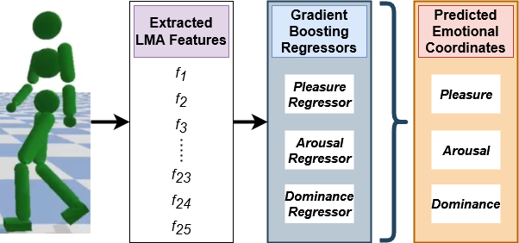
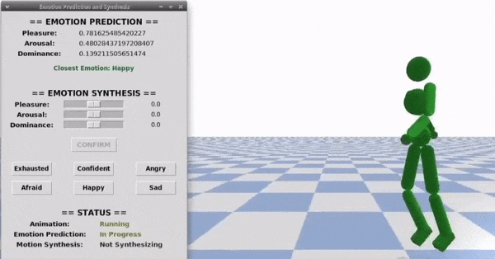
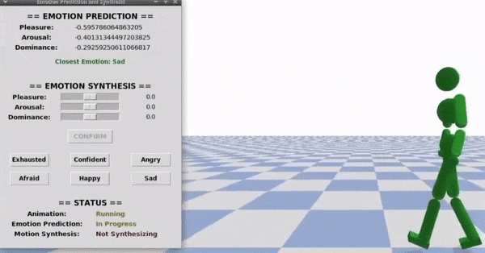
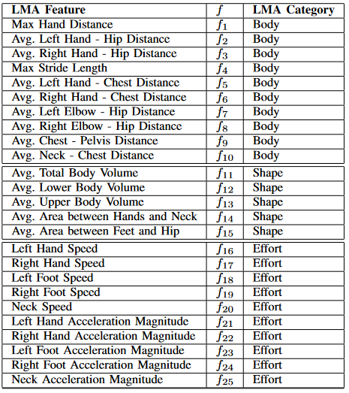
EMOTIONAL Identification
Notes:
1. Using the LMA To PAD Regressors the Emotion Classifier can then predict the character's emotion in real time.
2. During the course of the animation the LMA Features extracted by the LMA Feature Extractor are buffered. When 10 sets are stored a new multi threaded process
Is started. This process will predict the emotion of each stored set, compute the average and output it. The individual predictions are also stored internally
3. At the end of the animation, we use the stored predictions to make a prediction of the animation's overall emotion using a weighted average, giving more weight
To the highest absolute values for each emotion. The idea behind this is that during the course of the animation the emotional intensity of the character can vary,
But it will at some point reach a peak, or valley, value, indicative of the true emotion the character is trying to convey.
4. We can see her the results of our emotional prediction displayed on the showcase GUI and the fact that this process has a pretty much null performance impact on
the animation's showcase.

Slide 7
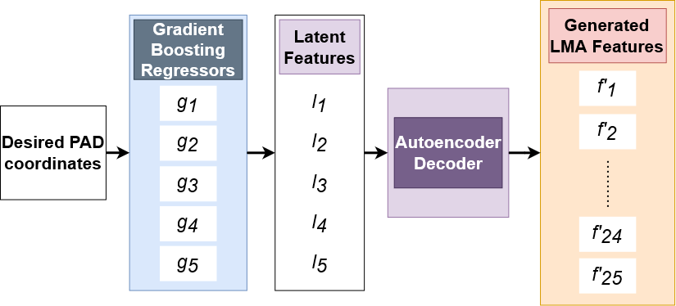
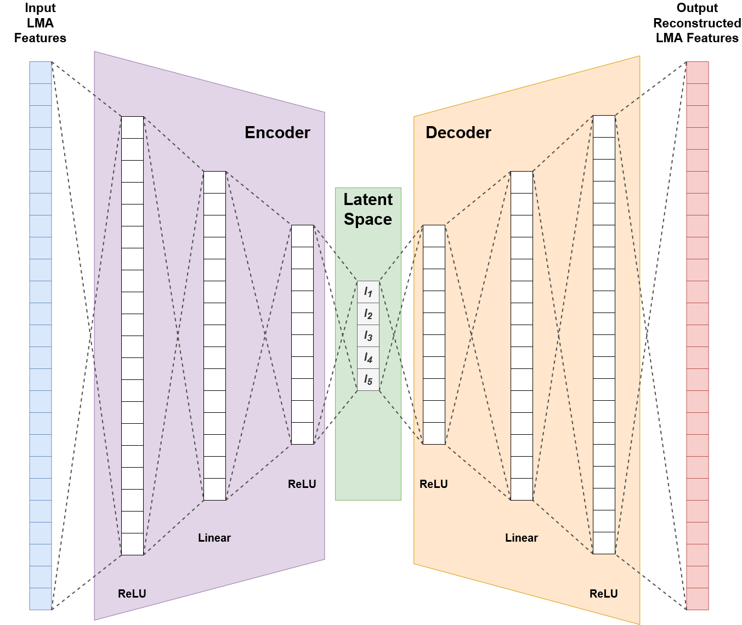
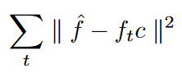
MOTION SYNTHESIS
Generate new set of LMA Features
Compute new desired positions/rotations for core joints
6 Heuristic Rules
Coefficients to represent the difference between Baseline's and Generated LMA Features
Notes:
1. So now for the actual process of motion synthesis. During the baseline animation's first playback all LMA Features computed by the LMA Feature Extractor are stored internally
So that we always have the Baseline LMA Features.
2. When new coordinates get specified the system begins by using either PAD To LMA methodologies to generate a new
Set of LMA Features
3. Then the Motion Synthesis module starts a new multi threaded process. This module uses a set of 6 heuristic rules to determine new core joint positions/rotations for the character.
The core joints include the Hips, Chest, Hands, Elbows, Feet and Neck. We focused primarily on upper body joints since studies have proven that these are the main joints used for emotional
Expression, whilst lower body joints are mainly used for stabilization. Each rule has a coefficient and a set of features associated with the joint it is trying to change.
4. The idea behind each rule is basically to modify the character's joint in order to bring its LMA Features closer to the generated ones. To do so, each rule has coefficients which act as
A value representative of the difference between the generated and baseline subset of LMA Features for that rule.
5. Whenever new LMA Features are generated, we first compute the coefficients for each rule. These coefficients are computed as the value that minimizes the error
Between each rule's subset of LMA Features. This basically boils down to an optimization process of minimizing this equation for coefficient c
which is solved using Powells method. Each coefficient is initialized at 1.0.
6. After having the coefficients each rule can be called to generate the new joint positions sequentially by modifying the baseline's. This can be done either as a batch, where we generate the new
Set of joint positions and rotations for each of the character's poses at once, or every single frame. It should be noted that the batch method only works when we have
A Kinematic character controller, which gives us access to the character's pose at every keyframe, meaning we can generate the new positions for every one of them at once. This is not the case
For learned policy-based physics-enabled controllers which generate the character's pose at every frame, meaning we have to compute the modifications right after the pose is generated.

Slide 8
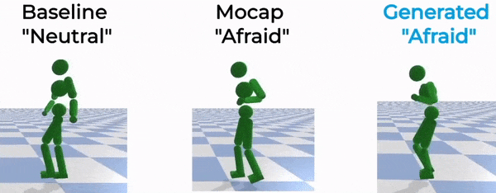
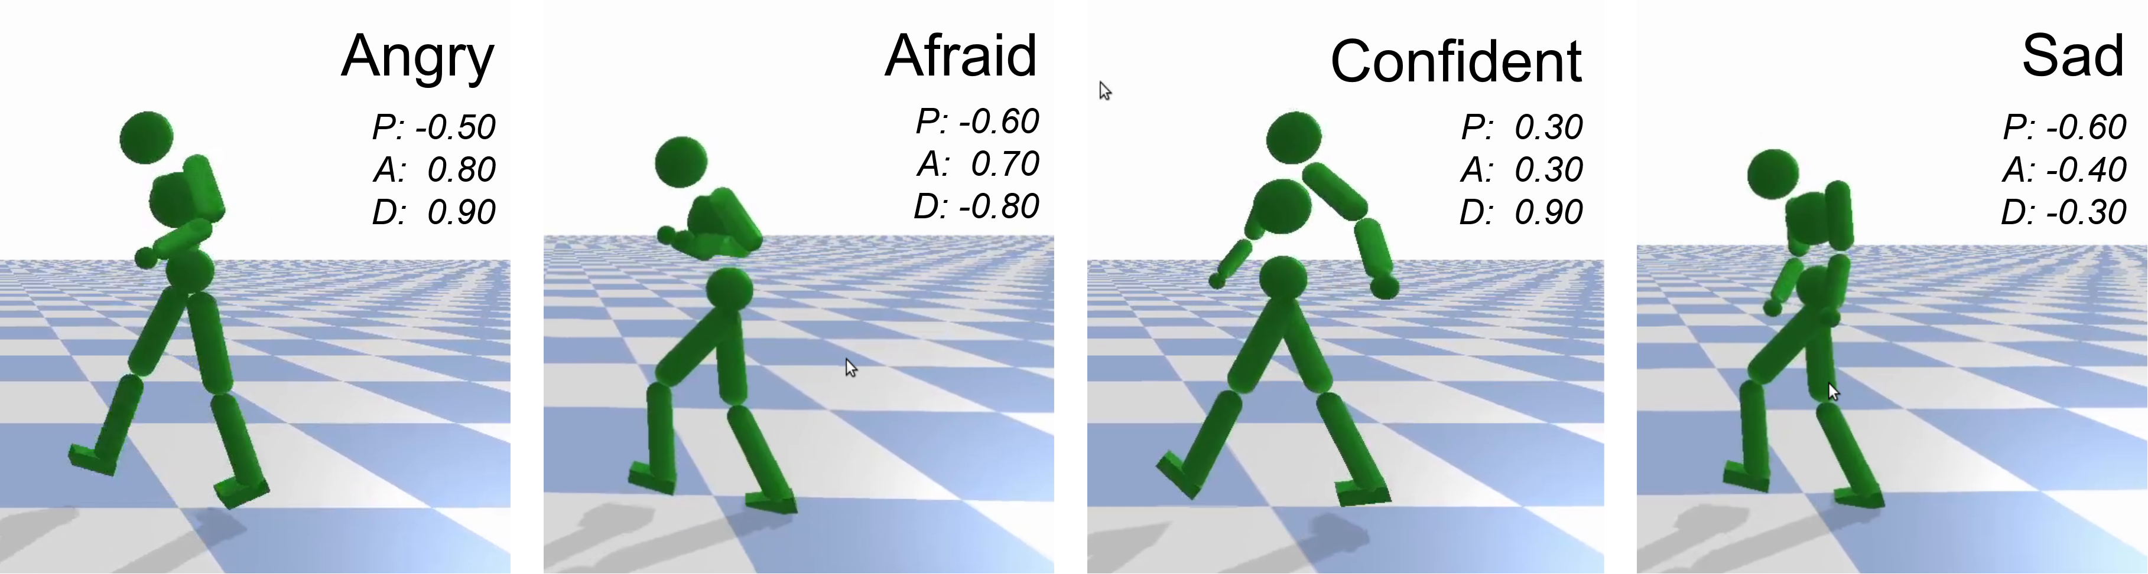
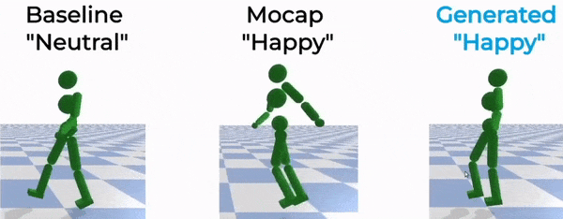
MOTION SYNTHESIS
Notes:
1. Just having the character's desired joint positions is not enough however. A new pose has to be synthesized by modifying the baseline pose in order to move the joints to their desired positions
Without breaking the character's line of motion, or twisting its body unnaturally. To do so we use an Inverse Kinematics Solver to generate and output the new poses.
2. These poses can then be directly applied to the character, replacing its baseline pose, which effectively will alter its movements in order to convey the new desired emotion, as can be seen here.

Slide 9
CONCLUSION
Automatic System for Emotionally Expressive Motion Synthesis of Locomotion Animations
Works with both Kinematic and Policy-Based Physics-Enabled Character Controllers
Emotions specified using the PAD Model
Emotional Prediction and Motion Synthesis in Real Time
Quality of synthesized motions validated through User Tests
Notes:
1. So in conclusion, we have built a system that allows users to easily alter a character's baseline motion in order to make it convey different emotions, without the need for extra
Data or manual animation labor. Furthermore the system works with both kinematic character controllers reading directly from a mocap file, or by automatically learned policy-based
Physics enabled character controllers.
2. Our framework synthesizes motions in real time, meaning it could be used to both directly generate new animations offline to be stored and used later, or online by an application
That requires characters to shift their emotions without resorting to interpolating between different animation files
3. New emotions can be specified through PAD coordinates, which gives a higher grade of control over the intensity of the outcome emotion.
4. Our system was validated through a set of user tests and has been since reviewed and accepted by field specialists for publishing in an international IEEE conference.
---
1. There are, however, ways we could further improve our system.
2. For one it would be beneficial to expand the dataset used to train the models, not only to make it more compatible with non-locomotion animations, but also
To increase the number of emotions in the train set.
3. We also experimented with the usage of Generative Adversarial Networks and Variational AutoEncoders for feature generation, but were unable to reach results
Better than the aforementioned techniques for LMA Feature Generation. We believe this avenue is still worthy of exploring, however, especially with an extended dataset of motions.

Slide 10
Thank you for listening!
More Info at: https://heroufenix.github.io/expressive_animations_web/

